Slide 1
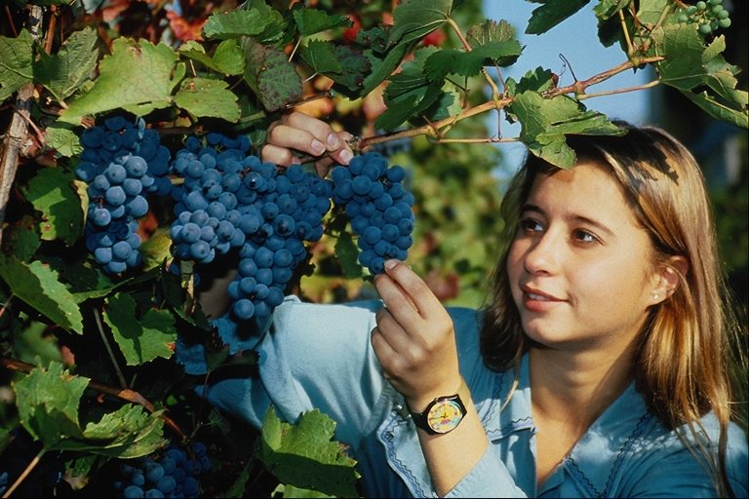
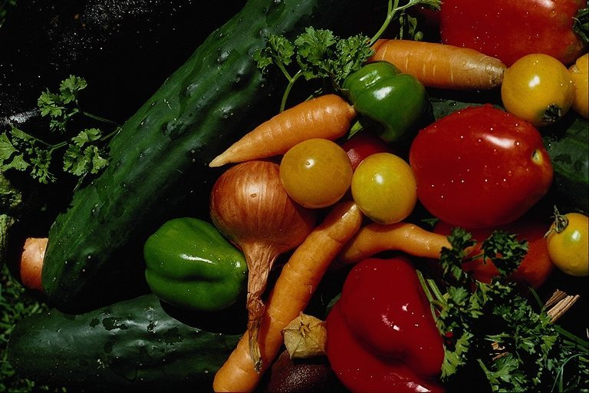

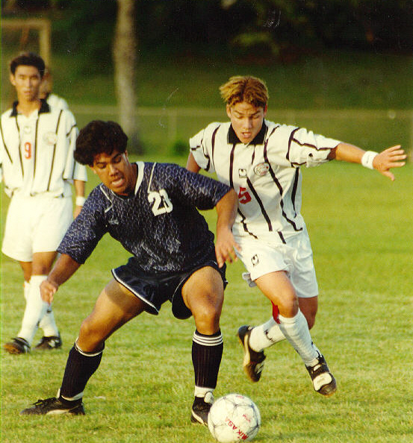
How can you burn calories?

Slide 2
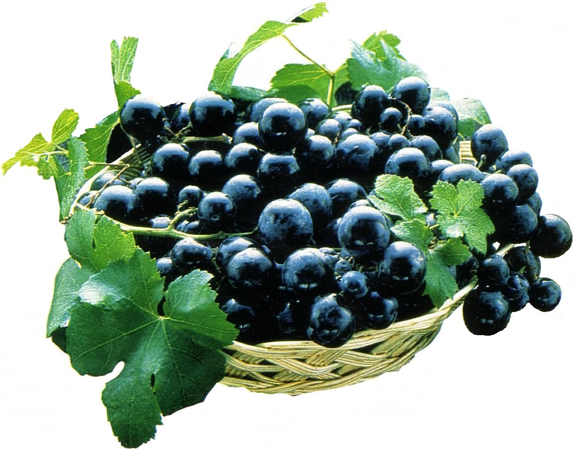
Vocabulary
1. carbohydrates – углеводы
2. reduce – сокращать
3. consumption – содержание

Slide 3
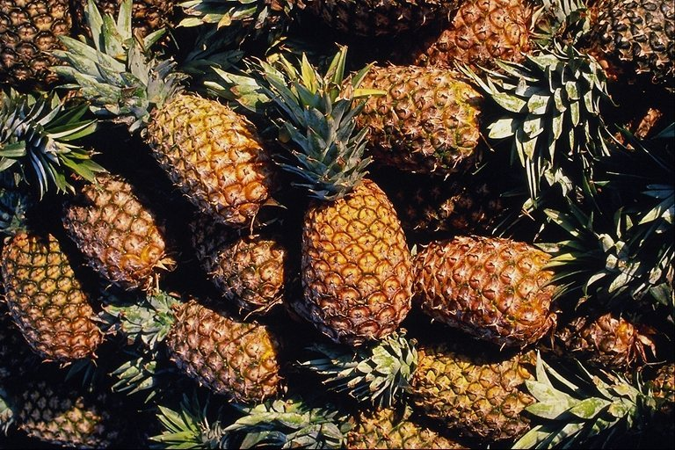
Choose the correct answer
Be physically active at least three times a week.
True
False
back
menu

Slide 4
Be physically active at least three times a week.
False
Be physically active every day.
back
menu
next

Slide 5
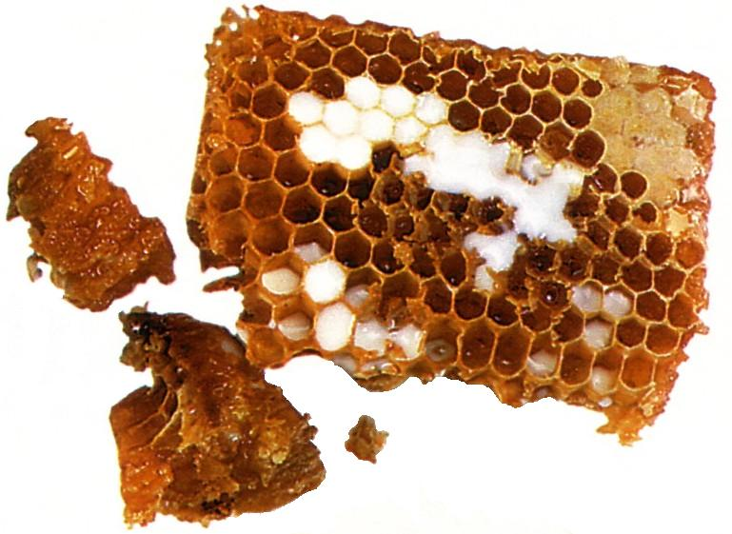
Choose the correct answer
Eat more fruits and vegetables every day.
True
False
back
menu

Slide 6
Eat more fruits and vegetables every day.
True
back
menu
next

Slide 7
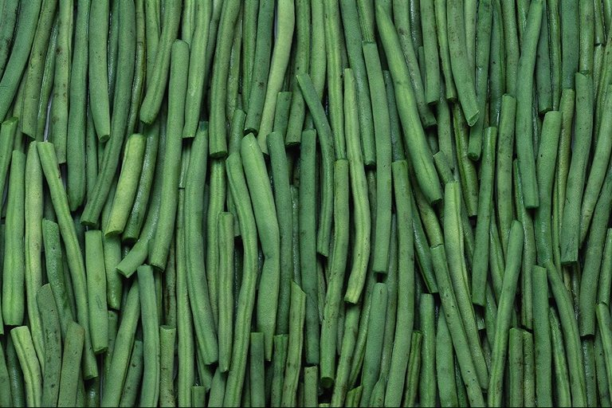
Choose the correct answer
Reduce the consumption of whole grains, non-fat and low-fat milk, and milk products.
True
False
back
menu

Slide 8
Reduce the consumption of non-fat and low-fat milk, and milk products.
False
You should eat more fruits and vegetables, non-fat and low-fat milk and milk products.
back
menu
next

Slide 9
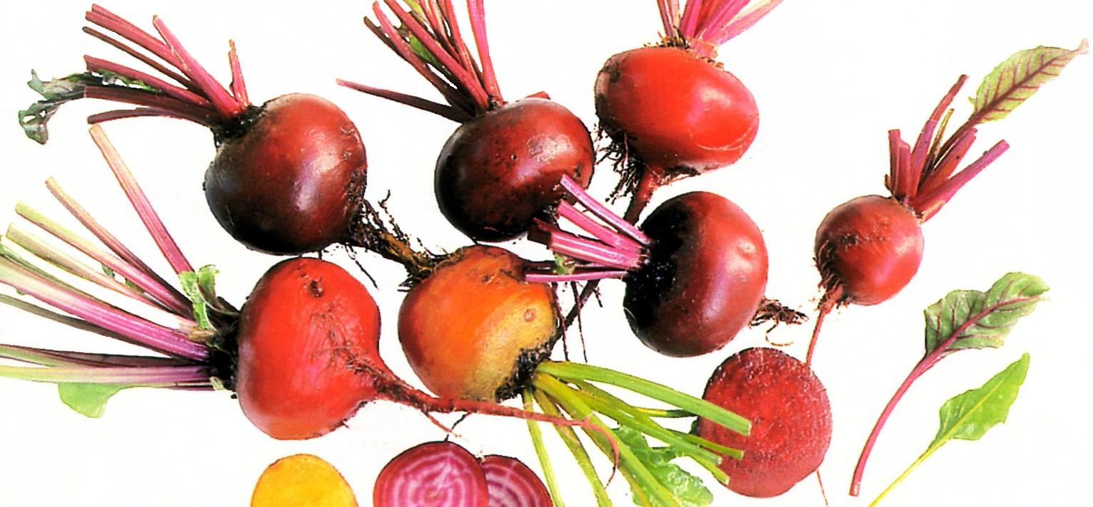
Choose the correct answer
Choose fats for good health.
True
False
back
menu

Slide 10
Choose fats wisely for good health.
True
back
menu
next

Slide 11
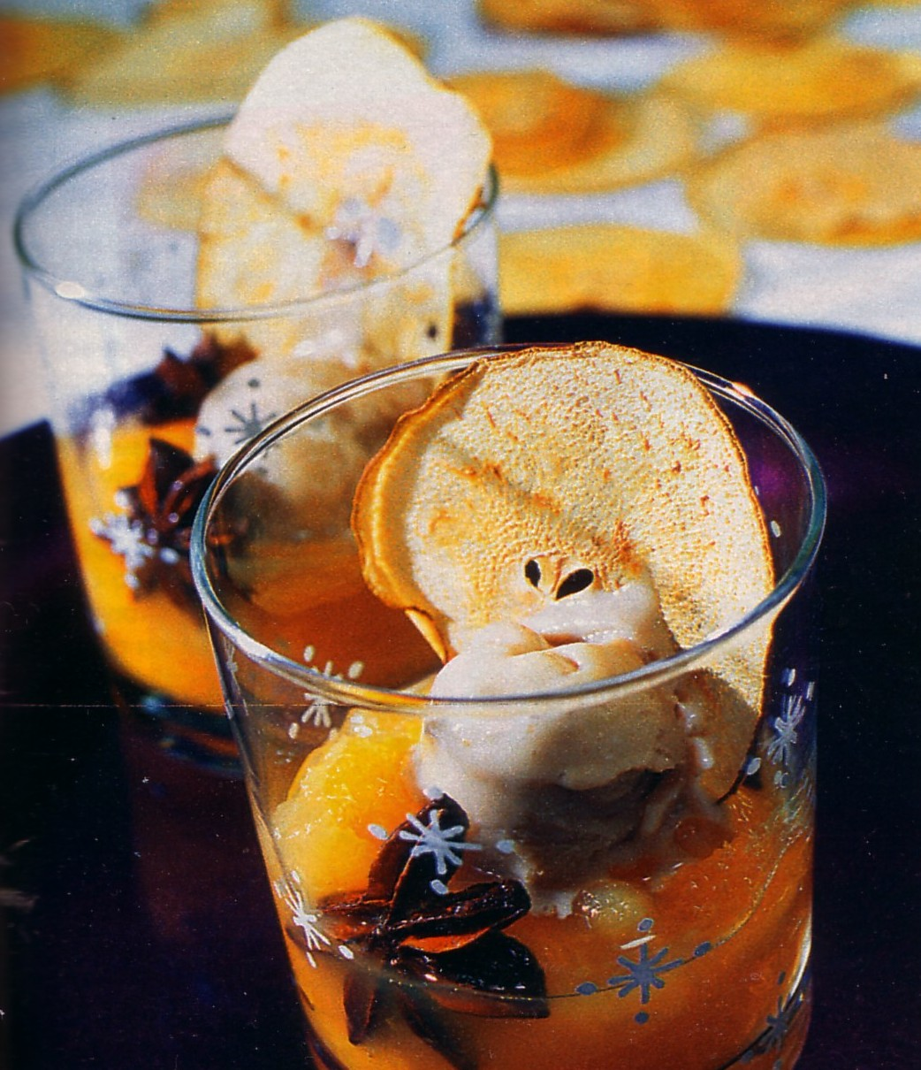
Choose the correct answer
In order to be in good health, don’t consume carbohydrates.
True
False
back
menu

Slide 12
In order to be in good health, don’t consume carbohydrates.
False
Choose carbohydrates carefully for good health.
back
menu
next

Slide 13
Listen attentively
.
A1 Chinese people eat a lot of _______because it brings them
good luck.
Sweets 2. Sea food 3. Cakes
A2 Scottish people clean their houses before the New Year
because _______.
Their houses are dirty. 2. They haven’t got enough time
during the year.
3. They follow the tradition.
A3 Chinese people celebrate the New Year ______.
On the particular day of the year.
2. At the same time with the whole world.
3. On the special day according to the moon calendar.
A4 Julia’s parents present her some money because _________.
1. She hasn’t a husband yet. 2. She is still a child 3. She needs it.

Slide 14
Choose the subject
Grammar 1 2 3 4
Vocabulary 1 2 3 4

Slide 15
Grammar 1
My friend Tom told me that physical activity ________ good for my health.
1) is
2) will be
3) would be
4) more good
В начало

Slide 16
Grammar 2
Emily said to her friends that she ______ too much fast food.
1) wouldn’t eat
2) are eating
3) has eaten
4) eats
В начало

Slide 17

Grammar 3
Peter said that the balanced diet ______ a very important thing.
1) is
2) were
3) will be
4) was
В начало

Slide 18
Grammar 4
My friend Liz said that she _______to phone me the next day.
1) Would try
2) Will try
3) Is trying
4) try
В начало

Slide 19
Vocabulary 1
Сжигать калории
1)To eat calories
2) To burn calories
3) To count calories
4) To contain calories
В начало

Slide 20
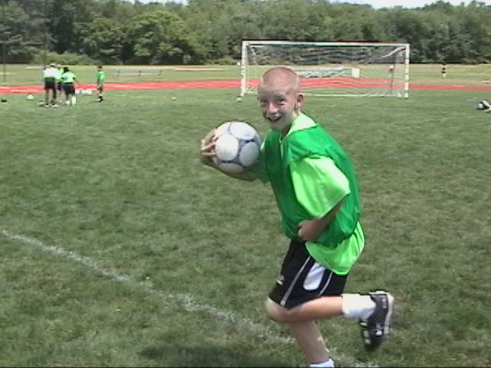
Vocabulary 2
Физическая активность
1) activities
2) Physical activity
3) Physics activity
4) Physically active
В начало

Slide 21
Vocabulary 3
Содержать энергию
1) To be energetic
2) To contain energy
3) To contain fats
4) energy
В начало

Slide 22
Vocabulary 4
Finish the proverb:
“ _______ a day keeps the doctor away.”
1) an apple
2) a carrot
3) a cucumber
4) an orange
В начало

